Slide 1

Chapter 26 – Web Applications

Slide 2
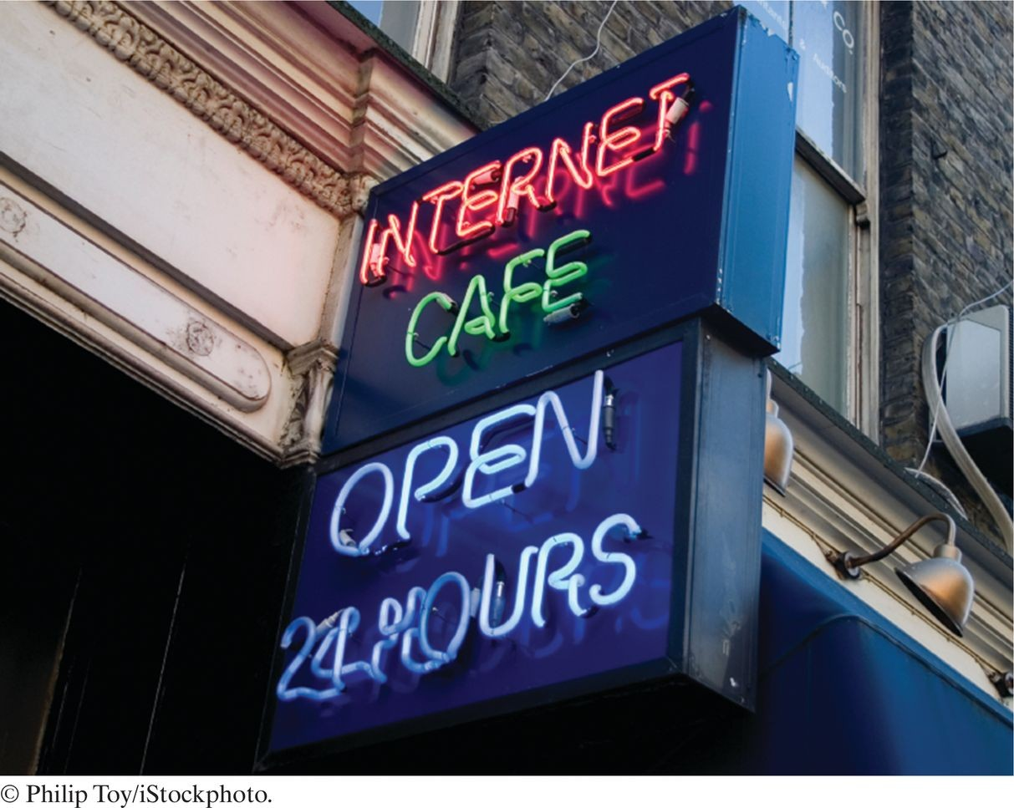
Chapter Goals
To understand the web application concept
To learn the syntactical elements of the JavaServer Faces web application framework
To manage navigation in web applications To build three-tier web applications

Slide 3
The Architecture of a Web Application
Web application: an application whose user interface is displayed in a web browser.
Application program resides on a web server.
User fills out form elements and clicks on buttons and links.
User inputs are transmitted over the Internet to the server using the HTTP protocol.
Server responds by sending a new web page in HTML format.

Slide 4
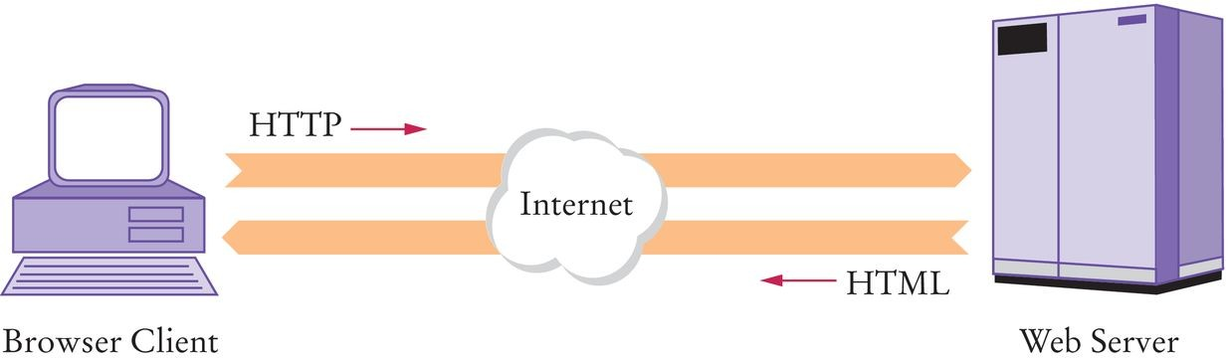
The Architecture of a Web Application
Figure 1 The Architecture of a Web Application

Slide 5
Link Request
When the user clicks on a link, the browser asks the server for the page with a given address.
Example:
GET /index.html HTTP/1.1 Host: horstmann.com

Slide 6
Form Request
When the user fills data into a form and clicks on a button, the HTTP request includes the user's data.
Example:
POST /login.xhtml HTTP/1.1 Host: horstmann.com
Content-Type: application/x-www-form-urlencoded Content-Length: 46
blank line username=jqpublic&passwd=secret&login=Log%20in

Slide 7
A Simple Form
HTML code:
<html>
<head>
<title>A Simple Form</title>
</head>
<body>
<form action="login.html">
<p>
User name:
<input type="text" name="username" /> Password:
<input type="password" name="passwd" />
<input type="submit" name="login" value="Log in"/>
</p>
</form>
</body>
</html>

Slide 8
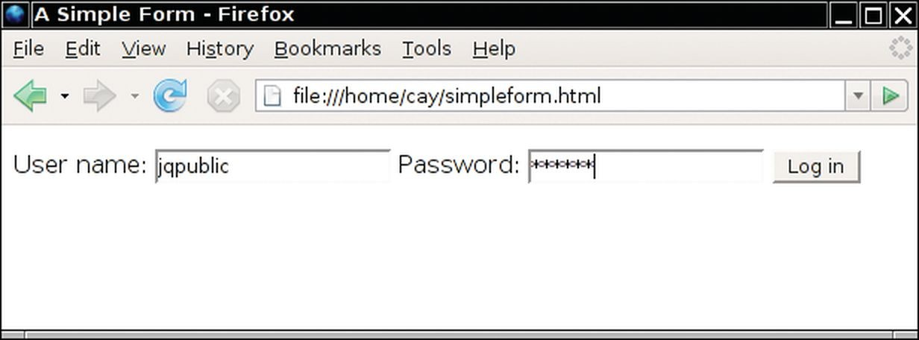
A Simple Form
Figure 2 A Simple Form

Slide 9
Web Application Challenges
HTTP protocol is stateless – there is no memory of which form was last sent when a new request is received.
Tedious to generate tags for an HTML form.
Very hard to comprehend response strategies for a large number of request types.
A web application framework is designed to overcome these challenges. Example: JavaServer Faces (JSF) framework.

Slide 10
Self Check 26.1
Why are two different protocols (HTML and HTTP) required by a web application?
Answer: Each protocol has a specific purpose. HTML describes the appearance of a page; it would be useless for sending requests from a browser to a server. HTTP describes a request; it cannot describe the appearance of a page.

Slide 11
Self Check 26.2
How can a web application know which user is trying to log in when the information of the sample login screen is submitted?
Answer: The data of the POST request contain a portion username=the name supplied by the user&password=the password supplied by the user.

Slide 12
Architecture of a JSF Application
The user interface of a JSF application is described by a set of JSF pages. Each JSF page has the following structure:
<?xml version="1.0" encoding="UTF-8"?>
<html xmlns=http://www.w3.org/1999/xhtml xmlns:h=http://java.sun.com/jsf/html>
<h:head>
<title>Page title</title>
</h:head>
<h:body>
<h:form>
Page contents
</h:form>
</h:body>
</html>
A JSF page contains HTML and JSF tags, i.e. tags with prefix "h:".

Slide 13
section_2/time/index.xhtml
<?xml version="1.0" encoding="UTF-8"?>
<html xmlns="http://www.w3.org/1999/xhtml"
xmlns:h="http://java.sun.com/jsf/html">
<h:head>
<title>The time application</title>
</h:head>
<h:body>
<h:form>
9 <p>
10 The current time is #{timeBean.time}
11 </p>
</h:form>
</h:body>
</html>

Slide 14
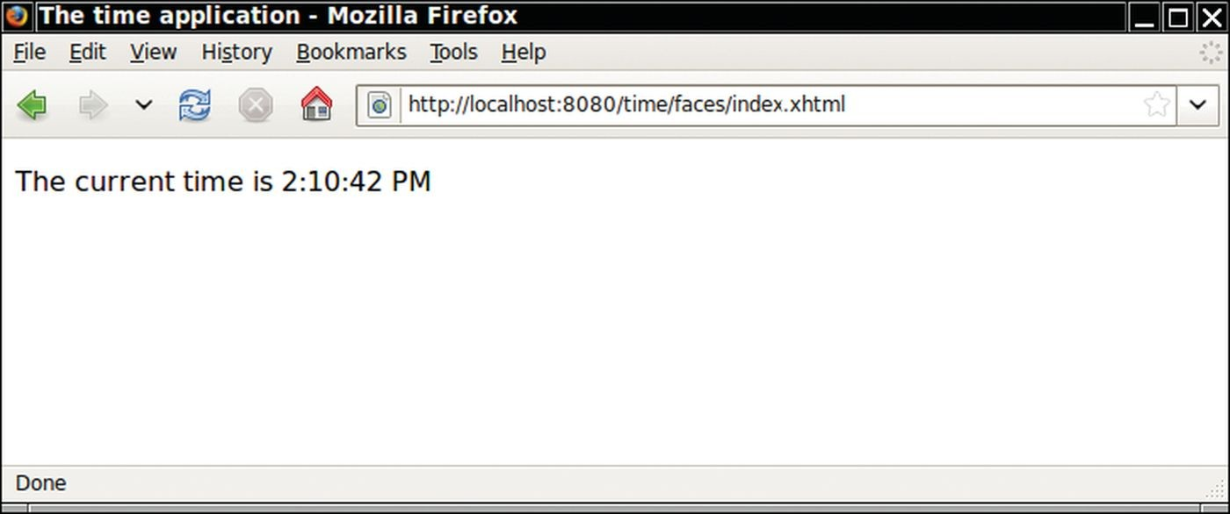
time Web Application
Figure 3 JSF index page for time web application

Slide 15
JSF Container
JSF container: server-side software that implements the JSF framework.
Translates all JSF tags into text and HTML tags, yielding a pure HTML page.
Basic process:
HTML tags in the page are retained; they are the static part of the page.
JSF tags are translated into HTML; translation is dynamic, it depends on the state of Java objects associated with the tags.
E.g. #{timeBean.time} is replaced by dynamically generated text, namely the current time.
Figure 4 The JSF Container Rewrites the Requested Page

Slide 16
Managing Beans
#{timeBean.time} is a value expression.
Value expressions invoke method calls on Java objects, called managed beans.
Managed beans are “managed” by the JSF container.
JSF container creates a managed bean when it is first used in a value expression.
Scope of the managed bean determines which clients can access the object and how long the object stays alive.
Bean with session scope is available for multiple requests by the same browser.

Slide 17
section_2/time/WEB-INF/ classes/bigjava/TimeBean.java
1 package bigjava;
2
import java.text.DateFormat;
import java.util.Date;
import java.util.TimeZone;
import javax.faces.bean.ManagedBean;
import javax.faces.bean.SessionScoped;
8
9
10
11
12
13
14
15
16
17
18
19
20
21
22
23
24
25
26
27
28
29
30
31
32
33 }
@ManagedBean
@SessionScoped public class TimeBean
{
private DateFormat timeFormatter;
/**
Initializes the formatter.
*/
public TimeBean()
{
timeFormatter = DateFormat.getTimeInstance();
}
/**
Read-only time property.
@return the formatted time
*/
public String getTime()
{
Date time = new Date();
String timeString = timeFormatter.format(time); return timeString;
}

Slide 18
Managed Beans
Declare a session-scoped managed bean with annotations @ManagedBean
and @SessionScoped.
Name of the bean in a value expression is the class name with the first letter changed to lowercase, e.g. timeBean.
Value expression timeBean.time calls the getTime method (see the reason in the next section).
Method getTime uses class DateFormat to format the current time, producing a string such as 9:00:00 AM.

Slide 19
Managed Beans
When deploying the application, all class files must be placed inside the
WEB-INF/classes directory.
Many application servers also require that classes be contained in a package.
Place our classes inside the bigjava package.

Slide 20
Separation of Presentation and Business Logic
Every JSF application has two parts: presentation and business logic. Presentation: the user interface of the web application — the arrangement of the text, images, buttons, etc.
Business logic: the part of the application that is independent of the visual presentation.
In commercial applications, it contains the rules that are used for business decisions — what products to offer, how much to charge, to whom to extend credit, etc.
Our example simulates the business logic with a TimeBean object.

Slide 21
Separation of Presentation and Business Logic
JSF pages define the presentation logic. Managed beans define the business logic. Value expressions tie the two together.
Separation of presentation logic and business logic is very important when designing web applications.

Slide 22
Deploying a JSF Application
Requires a server with a JSF container; e.g. GlassFish application server.
Make a separate directory tree for each web application.
Place JSF pages (such as index.xhtml) into the root directory of the application's directory tree.
Create a WEB-INF subdirectory in your application directory.
Place your Java classes inside WEB-INF/classes with classes inside a package. Compile with:
cd WEB-INF/classes
javac -classpath glassfish/modules/jsf-api.jar bigjava/*.java

Slide 23
Deploying a JSF Application
Place the file web.xml inside the WEB-INF directory.
Zip up all application files into a file with extension .war (Web Archive) using commands like:
cd time
jar cvf time.war .
Start the web server.
Deploy the application to the application server.
With GlassFish, this can be achieved either through the administrative interface or simply by copying the WAR file into a special deployment directory.
Point your browser to the application server using a URL such as:
http://localhost:8080/time/faces/index.xhtml

Slide 24
section_2/time/WEB-INF/web.xml
<?xml version="1.0" encoding="UTF-8"?>
<web-app xmlns:xsi="http://www.w3.org/2001/XMLSchema-instance"
xmlns="http://java.sun.com/xml/ns/javaee"
xmlns:web="http://java.sun.com/xml/ns/javaee/web-app_2_5.xsd"
xsi:schemaLocation="http://java.sun.com/xml/ns/javaee
http://java.sun.com/xml/ns/javaee/web-app_2_5.xsd"
version="2.5">
<servlet>
<servlet-name>Faces Servlet</servlet-name>
<servlet-class>javax.faces.webapp.FacesServlet</servlet-class>
</servlet>
<servlet-mapping>
<servlet-name>Faces Servlet</servlet-name>
<url-pattern>/faces/*</url-pattern>
</servlet-mapping>
<welcome-file-list>
<welcome-file>faces/index.xhtml</welcome-file>
</welcome-file-list>
<context-param>
<param-name>javax.faces.PROJECT_STAGE</param-name>
<param-value>Development</param-value>
</context-param>
</web-app>

Slide 25
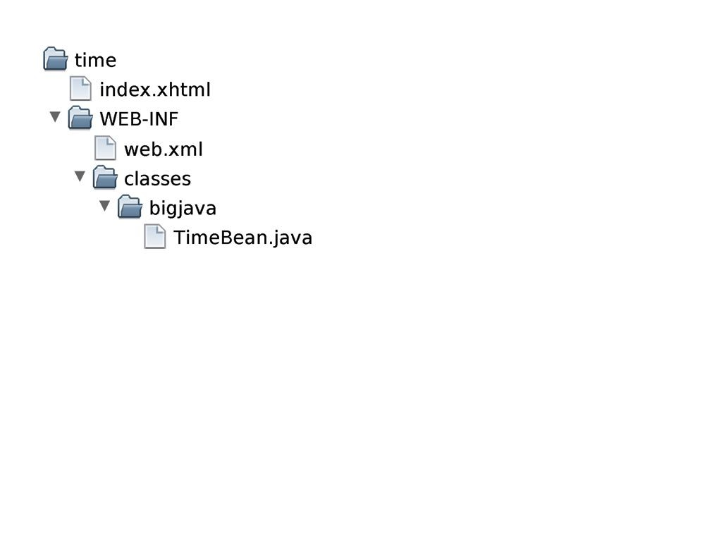
Directory Structure of the time Application
Figure 5 The Directory Structure of the time Application

Slide 26
section_2/time/WEB-INF/web.xml
<?xml version="1.0" encoding="UTF-8"?>
<web-app xmlns:xsi="http://www.w3.org/2001/XMLSchema-instance"
xmlns="http://java.sun.com/xml/ns/javaee"
xmlns:web="http://java.sun.com/xml/ns/javaee/web-app_2_5.xsd"
xsi:schemaLocation="http://java.sun.com/xml/ns/javaee
http://java.sun.com/xml/ns/javaee/web-app_2_5.xsd"
version="2.5">
<servlet>
<servlet-name>Faces Servlet</servlet-name>
<servlet-class>javax.faces.webapp.FacesServlet</servlet-class>
</servlet>
<servlet-mapping>
<servlet-name>Faces Servlet</servlet-name>
<url-pattern>/faces/*</url-pattern>
</servlet-mapping>
<welcome-file-list>
<welcome-file>faces/index.xhtml</welcome-file>
</welcome-file-list>
<context-param>
<param-name>javax.faces.PROJECT_STAGE</param-name>
<param-value>Development</param-value>
</context-param>
</web-app>

Slide 27
Self Check 26.3
What steps are required to add the image of a clock to the time application? (The clock doesn’t have to show the correct time.)
Answer: Place an image file, say clock.gif, into the time directory, and add a tag <img src="clock.gif"/> to the index.xhtml file.

Slide 28
Self Check 26.4
Does a Swing program automatically separate presentation and business logic?
Answer: No—it is possible (and sadly common) for programmers to place the business logic into the frame and component classes of the user interface.

Slide 29
Self Check 26.5
Why does the WAR file need to be deployed to the application server?
Answer: The application server knows nothing about the files on your computer. You need to hand it the WAR file with all the application’s pages, code, and configuration files so that it can execute the application when it receives a web request.

Slide 30
JavaBeans Components
Software component: an entity that encapsulates functionality and can be plugged into a software system without programming.
Example: the timeBean object.
Java does have explicit support for components.
In Java, use a programming convention to implement components.
JavaBean: a Java class that follows this convention.
A JavaBean exposes properties – values of the component that can be accessed without programming.

Slide 31
JavaBean Requirements
JavaBean requirements:
Must have a public constructor with no parameters.
Must have methods for accessing the component properties that follow the
get/set naming convention.
For example, to get or set a property named city, must declare methods
getCity and setCity.
For a property with name propertyName and type Type:
public Type getPropertyName()
public void setPropertyName(Type newValue)

Slide 32
JavaBean Properties
The name of a property starts with a lowercase letter, e.g. city.
The corresponding methods have an uppercase letter, e.g. getCity.
Exception: property names can be all capitals, e.g. properties ID and URL, with methods getID and setURL.
Read-only property: has only a get method.
Write-only property: has only a set method.
A JavaBean can have additional methods, but they are not connected with properties.

Slide 33
JavaBean Class
Example: a bean class that formats the time for a given city, with properties
city and time:
public class TimeZoneBean
{
// Instance variables
. . .
// Required constructor with no parameters public TimeZoneBean() {. . . }
// city property
public String getCity() { . . . }
public void setCity(String newValue) { . . . }
// read-only time property
public String getTime() { . . . }
// Other methods
. . .
}

Slide 34
JavaBean Property Internals
Do not make any assumptions about the internal representation of properties.
Getter and setter methods may simply read or write an instance variable. They may also do other work.
Example: method getTime from the TimeBean formats the current time.

Slide 35
JavaBeans Value Expressions
When a property name is used in a value expression that is included in the JSF page, then the get method is involved.
Example: When string:
The current time is #{timeBean.time}
is rendered, the JSF container calls method getTime of the session’s
TimeBean instance.

Slide 36
JavaBean Input Value Expressions
The situation is more complex when a property name is used in an
h:inputText tag:
<h:inputText value="#{timeZoneBean.city}"/>
When the JSF page is first displayed, the container calls method getCity
and displays the current value of the city property.
When the user submits the page, the container calls method setCity. Sets the city property to the value that the user typed into the input field.

Slide 37
Self Check 26.6
Is the Scanner class a JavaBean?
Answer: No. The Scanner class does not have a constructor with no arguments.

Slide 38
Self Check 26.7
What work does the setCity method of the TimeZoneBean do?
Answer: There is no way of knowing without looking at the source code. Perhaps it simply executes a statement city = newValue, setting an instance variable of the bean class. But the method may also do other work such as checking whether the city name is valid or storing the name in a database.

Slide 39
Navigation Between Pages
The outcome string of an action determines the next page that the JSF container sends to the browser.
The next page is the outcome string with the .xhtml extension added.
Example: if the outcome string is error, the next page is error.xhtml.

Slide 40
Navigation - Computation
Often the next page depends on the result of some computation. Example: in the timezone application:
When the user clicks the submit button, move to the page next.xhtml and display the time in the user’s time zone.
However, if no time zone is available for the city, we display the page error.xhtml.

Slide 41
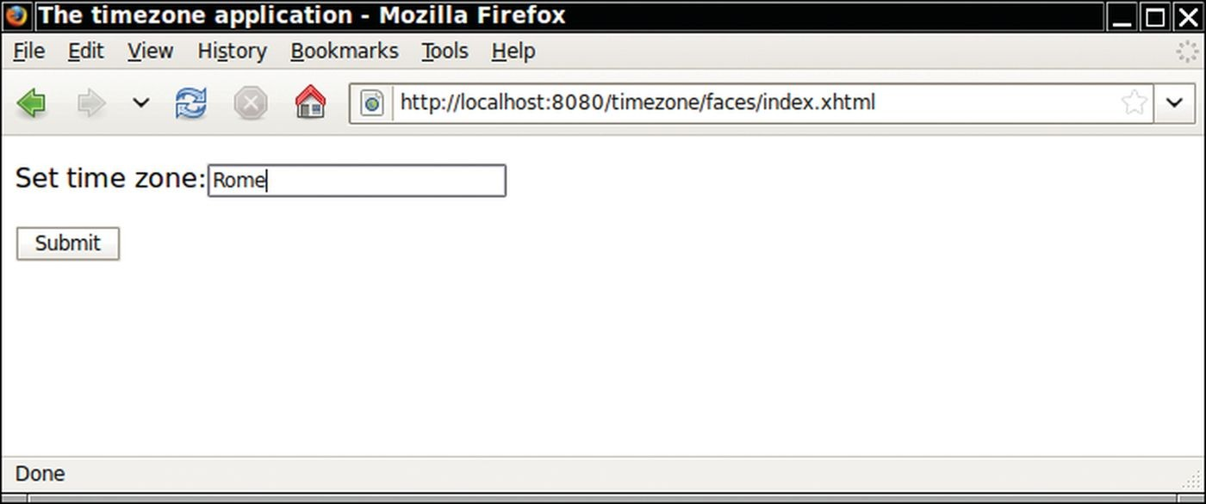
timezone Application

Slide 42
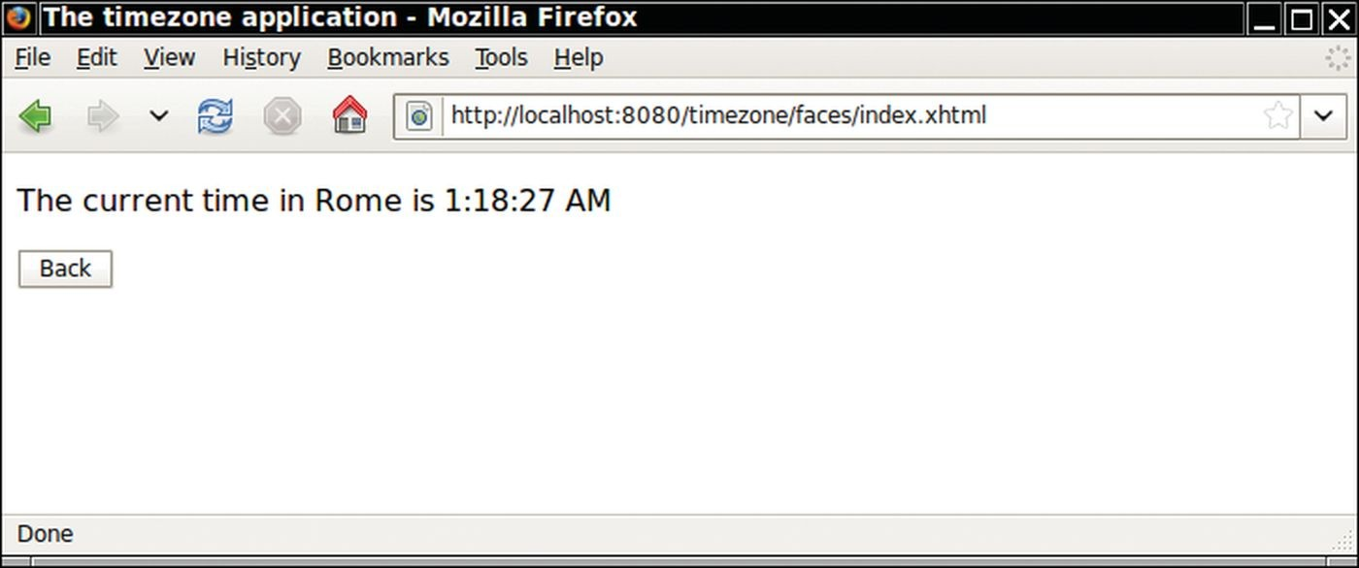
Figure 7 The timezone Application

Slide 43
Navigation - Method Expression
A method expression attribute specifies a bean and a method that should be invoked on the bean:
<h:commandButton value="Submit" action="#{timeZoneBean.checkCity}"/>

Slide 44
Navigation - Form Submission
When the form containing the above method expression is submitted, the container calls method timeZoneBean.checkCity() which returns the outcome string:
public class TimeZoneBean
{
. . .
public String checkCity()
{
zone = getTimeZone(city);
if (zone == null) { return "error"; } return "next";
}
}

Slide 45
Navigation - Action Attribute
If the next page does not depend on a computation, then you set the
action attribute of the button to a fixed outcome string:
<h:commandButton value="Back" action="index"/>
If a button has no action attribute, or if the action outcome is null, then the current page is redisplayed.

Slide 46
timezone Application - Determine Time Zone
In order to complete the application, need to be able to determine the time zone for the user's input city.
Java library contains a TimeZone class.
A time zone is identified by a string such as "America/Los_Angeles" or "Asia/Tokyo".
getAvailableIDs returns a string array containing all IDs:
String[] ids = TimeZone.getAvailableIDs();
getTimeZone returns a TimeZone object for a given ID string:
String id = "America/Los_Angeles"; TimeZone zone = TimeZone.getTimeZone(id);

Slide 47
timezone Application - Format Time
Use a DateFormat object to get a time string:
DateFormat timeFormatter = DateFormat.getTimeInstance(); timeFormatter.setTimeZone(zone);
Date now = new Date();
// Suppose the server is in New York, and it's noon there System.out.println(timeFormatter.format(now));
// Prints 9:00:00 AM

Slide 48
timezone Application - Interaction
Interaction with user:
The user will simply enter the city name.
The time zone bean will replace the spaces in the name with underscores. Then, check if that string appears at the end of one of the valid time zone IDs.

Slide 49
section_4/timezone/WEB-INF/ classes/bigjava/TimeZoneBean.java
1 package bigjava;
2
import java.text.DateFormat;
import java.util.Date;
import java.util.TimeZone;
import javax.faces.bean.ManagedBean;
import javax.faces.bean.SessionScoped;
8
9
10
11
12
13
14
15
16
17
18
19
20
21
22
23
24
25
26
27
28
29
30
31
32
33
34
35
/**
This bean formats the local time of day for a given city.
*/
@ManagedBean
@SessionScoped
public class TimeZoneBean
{
private DateFormat timeFormatter; private String city;
private TimeZone zone;
/**
Initializes the formatter.
*/
public TimeZoneBean()
{
timeFormatter = DateFormat.getTimeInstance();
}
/**
Setter for city property.
@param aCity the city for which to report the local time
*/
public void setCity(String aCity)
{
city = aCity;
}

Slide 50
timezone Application - Set the City
The next JSF page sets the city.
The h:inputText tag produces an input field. The h:commandButton tag produces a button.
When the user clicks the button, the browser sends the form values back to the web application.
The web application calls the setCity method on the bean because the input field has a #{timeZoneBean.city} value expression.

Slide 51
section_4/timezone/index.xhtml
<?xml version="1.0" encoding="UTF-8"?>
<html xmlns="http://www.w3.org/1999/xhtml"
xmlns:h="http://java.sun.com/jsf/html">
<h:head>
<title>The timezone application</title>
</h:head>
<h:body>
<h:form>
9 <p>
Set time zone:
<h:inputText value="#{timeZoneBean.city}"/>
12 </p>
13 <p>
<h:commandButton value="Submit"
action="#{timeZoneBean.checkCity}"/>
16 </p>
</h:form>
</h:body>
</html>

Slide 52
timezone Application - Results
The next JSF page shows the result, using two value expressions that display the city and time properties.
These expressions invoke the getCity and getTime methods of the bean class.

Slide 53
section_4/timezone/next.xhtml
<?xml version="1.0" encoding="UTF-8"?>
<html xmlns="http://www.w3.org/1999/xhtml"
xmlns:h="http://java.sun.com/jsf/html">
<h:head>
<title>The timezone application</title>
</h:head>
<h:body>
<h:form>
9 <p>
10 The current time in #{timeZoneBean.city} is #{timeZoneBean.time}
11 </p>
12 <p>
13 <h:commandButton value="Back" action="index"/>
14 </p>
</h:form>
</h:body>
</html>

Slide 54
section_4/timezone/error.xhtml
<?xml version="1.0" encoding="UTF-8"?>
<html xmlns="http://www.w3.org/1999/xhtml"
xmlns:h="http://java.sun.com/jsf/html">
<h:head>
<title>The multizone application</title>
</h:head>
<h:body>
<h:form>
9 <p>
10 Sorry, no information is available for #{timeZoneBean.city}.
11 </p>
12 <p>
13 <h:commandButton value="Back" action="index"/>
14 </p>
</h:form>
</h:body>
</html>

Slide 55
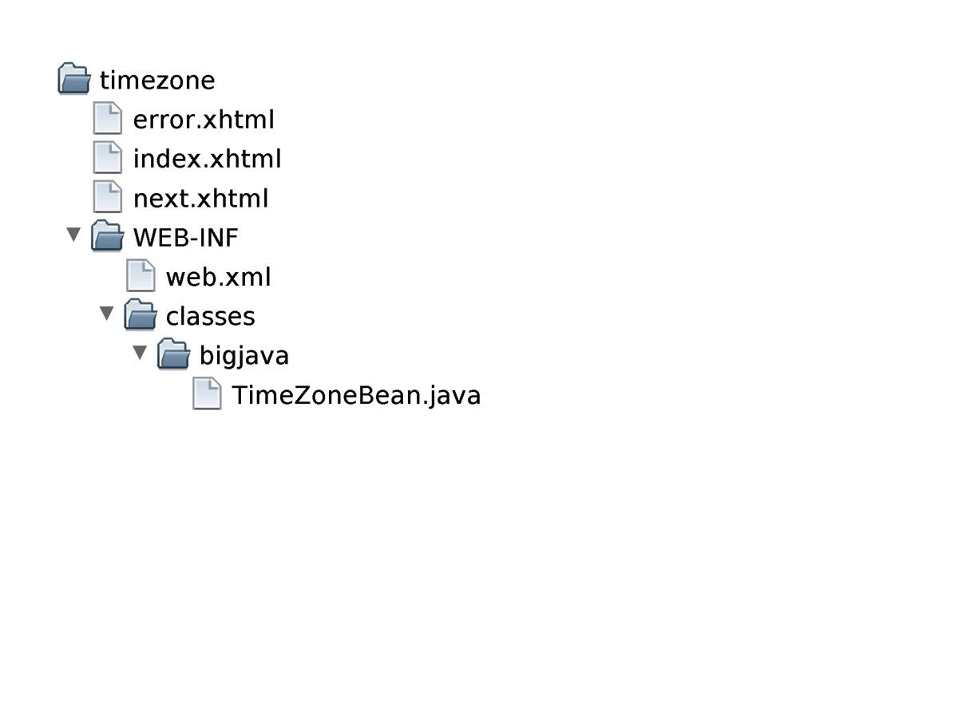
Directory Structure of timezone Application
Figure 8 The Directory Structure of the timezone Application

Slide 56
Self Check 26.8
What tag would you need to add to error.xhtml so that the user can click on a button labeled “Help” and see help.xhtml?
Answer: Add the tag <h:commandButton value="Help" action="help"/> to error.xhtml.

Slide 57
Self Check 26.9
Which page would be displayed if the checkCity method returned null instead of "error"?
Answer: The current page would be redisplayed.

Slide 58
JSF Components
There are JSF components for text input, choices, buttons, and images.
The value attribute of an input component denotes the value that the user supplies:
<h:inputSecret value="#{user.password}"/>

Slide 59
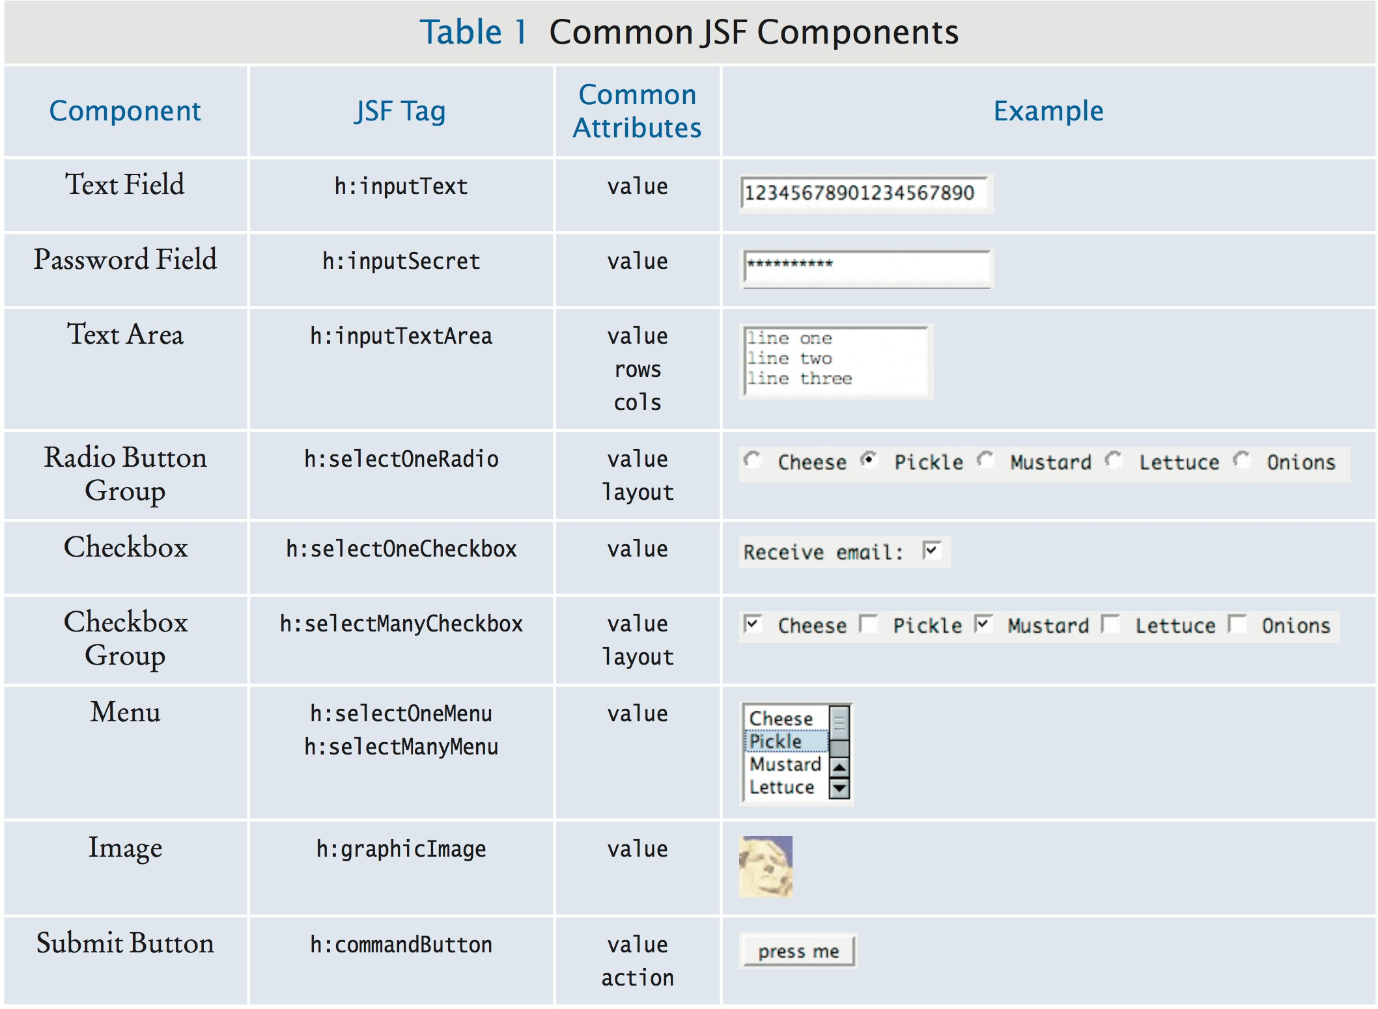
Common JSF Components

Slide 60
JSF Components
h:inputTextArea has attributes to specify the rows and columns:
<h:inputTextArea value="#{user.comment}" rows="10" cols="40"/>
Radio button and checkbox groups allow you to specify horizontal or vertical layout:
<h:selectOneRadio value="#{burger.topping}" layout="lineDirection">

Slide 61
Button Groups and Menus
Require two properties:
The collection of possible choices. The actual choice.
The value attribute specifies the actual choice to be displayed.
The collection of possible choices is defined by a nested f:selectItems
tag:
<h:selectOneRadio value="#{creditCardBean.expirationMonth}" layout="pageDirection">
<f:selectItem value="#{creditCardBean.monthChoices}"/>
</h:selectOneRadio>

Slide 62
Button Groups and Menus
When you use the f:selectItems tag, you need to add namespace declaration:
xmlns:f="http://java.sun.com/jsf/core"
monthChoices must have a type that can describe a list of choices.
For example, Map.
The keys of the map are the labels.
The corresponding map values are the label values.
LinkedHashMap allows an arbitrary order.
TreeMap would create a sorted order.

Slide 63
Button Groups and Menus
To create the list of choices:
public class CreditCardBean
{
...
public Map<String, Integer> getMonthChoices()
{
Map<String, Integer> choices = new LinkedHashMap<>();
choices.put("January", 1);
choices.put("February", 2);
...
return choices;
}
}

Slide 64
Button Groups and Menus
The type of the value property of the component must match the type of the Map value.
For example, creditCardBean.expirationMonth must be an integer.
If multiple selections are allowed, the type of the value property must be a list or array of matching types.

Slide 65
Self Check 26.10
Which JSF components can be used to give a user a choice between “AM/PM” and “military” time?
Answer: h:selectOneRadio, h:selectOneMenu, or
h:selectOneCheckbox

Slide 66
Self Check 26.11
How would you supply a set of choices for a credit card expiration year to a h:selectOneMenu
component?
Answer: You would need a bean with a property such as the following:
public Map<String, Integer> getYearChoices()
{
Map<String, Integer> choices = new TreeMap<>(); choices.put("2003", 2003);
choices.put("2004", 2004);
. . .
return choices;
}
Then supply a tag
<f:selectItems value="#{creditCard.yearChoices}"/>.

Slide 67
A Three-Tier Application
A three-tier application has separate tiers for presentation, business logic, and data storage:
The presentation tier: the web browser.
The "business logic" tier: the JSF container, the JSF pages, and the JavaBeans.
The storage tier: the database.

Slide 68
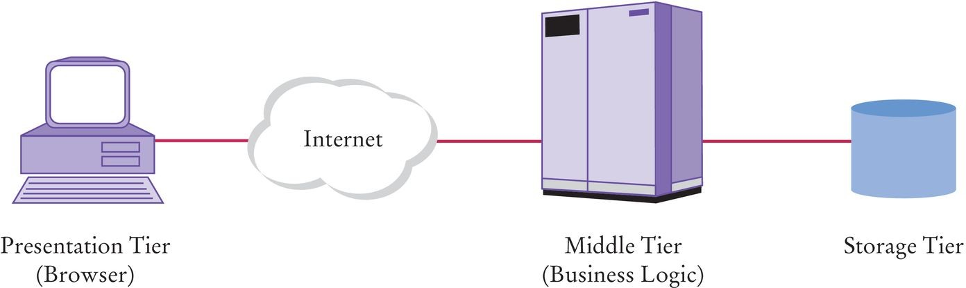
A Three-Tier Application
Figure 9 Three-Tier Architecture

Slide 69
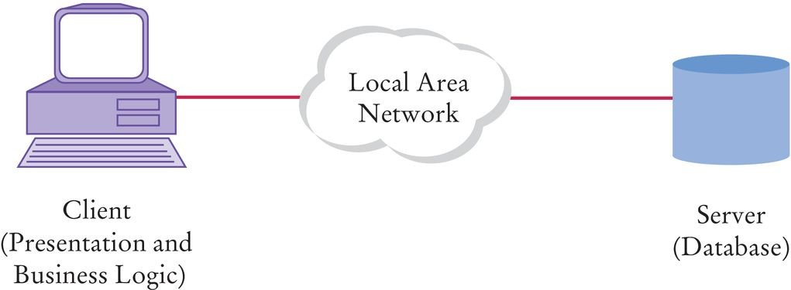
Two-Tier Client-Server Architecture
Figure 10 Two-Tier Architecture

Slide 70
A Three-Tier Application - Business Logic
If business logic changes:
In a two-tier application, new client program must be distributed over all desktops. In a three-tier application, server code is updated while presentation tier remains unchanged.
Simpler to manage.

Slide 71
A Three-Tier Application - CityZone table
Single database table, CityZone, with city and time zone names.
If TimeZoneBean can't find the city among the standard time zone IDs, it makes a query:
SELECT Zone FROM CityZone WHERE City = the requested city
If there is a matching entry in the database, that time zone is returned.

Slide 72
section_6/multizone/sql/CityZone.sql
CREATE TABLE CityZone (City VARCHAR(40), Zone VARCHAR(40))
INSERT INTO CityZone VALUES ('San Francisco', 'America/Los_Angeles')
INSERT INTO CityZone VALUES ('Hamburg', 'Europe/Rome')
SELECT * FROM CityZone

Slide 73
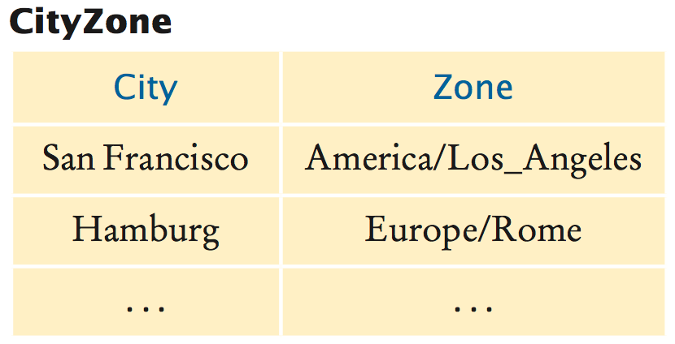
The CityZone Table
Figure 11 The CityZone Table

Slide 74
A Three-Tier Application - DataSource
To query the database, the bean needs a Connection object. GlassFish application server includes the Derby database.
Predefined data source with the resource name jdbc/ default. Declare an instance variable of type DataSource and tag it with a
@Resource annotation:
@Resource(name="jdbc/ default") private DataSource source;
When the application server loads the web application, it automatically initializes instance variable source.

Slide 75
Three-Tier Application - DB Connection
To get a database connection, call source method getConnection:
try (Connection conn = source.getConnection())
{
Use the connection
}
Use GlassFish administrative interface to define other data sources.

Slide 76
A Three-Tier Application - Connection Pool
Application server manages a pool of database connections. Pooling avoids the overhead of creating new database connections. Pooling is completely automatic.

Slide 77
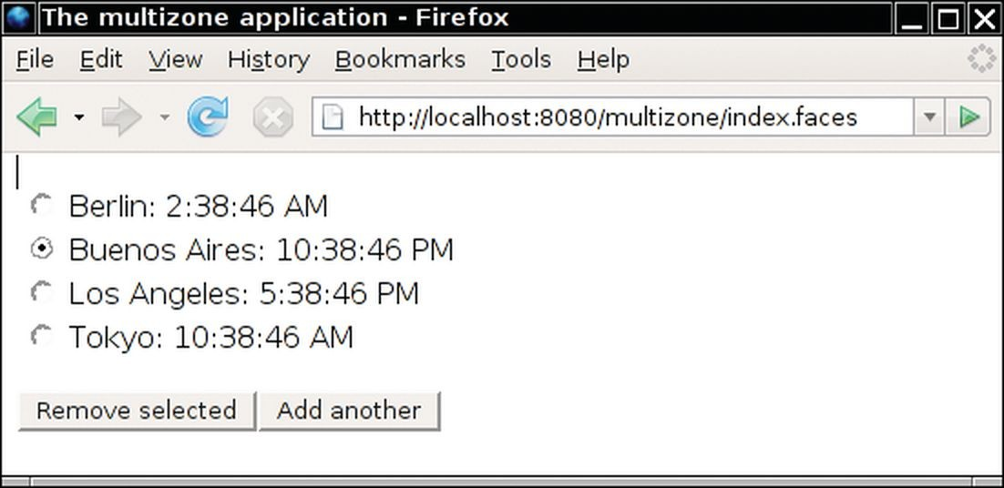
A Three-Tier Application - TimeZoneBean
Enhanced TimeZoneBean so that it manages a list of cities. Can add cities to the list and remove a selected city.
Figure 12 The multizone Application Shows a List of Cities

Slide 78

Directory Structure of the multizone
Application
Figure 13 Directory Structure of the multizone Application

Slide 79
section_6/multizone/index.xhtml
<?xml version="1.0" encoding="UTF-8"?>
<html xmlns="http://www.w3.org/1999/xhtml"
xmlns:h="http://java.sun.com/jsf/html">
<h:head>
<title>The multizone application</title>
</h:head>
<h:body>
<h:form>
9 <p>
Enter city:
<h:inputText value="#{timeZoneBean.cityToAdd}"/>
12 </p>
13 <p>
<h:commandButton value="Submit"
action="#{timeZoneBean.addCity}"/>
16 </p>
</h:form>
</h:body>
</html>

Slide 80
section_6/multizone/next.xhtml
<?xml version="1.0" encoding="UTF-8"?>
<html xmlns="http://www.w3.org/1999/xhtml"
xmlns:f="http://java.sun.com/jsf/core"
xmlns:h="http://java.sun.com/jsf/html">
<h:head>
<title>The multizone application</title>
</h:head>
<h:body>
<h:form>
10 <p>
<h:selectOneRadio value="#{timeZoneBean.cityToRemove}"
layout="pageDirection">
<f:selectItems value="#{timeZoneBean.citiesAndTimes}"/>
</h:selectOneRadio>
15 </p>
16 <p>
<h:commandButton value="Remove selected"
action="#{timeZoneBean.removeCity}"/>
<h:commandButton value="Add another" action="index"/>
20 </p>
</h:form>
</h:body>
</html>

Slide 81
section_6/multizone/error.xhtml
<?xml version="1.0" encoding="UTF-8"?>
<html xmlns="http://www.w3.org/1999/xhtml"
xmlns:h="http://java.sun.com/jsf/html">
<h:head>
<title>The multizone application</title>
</h:head>
<h:body>
<h:form>
9 <p>
10 Sorry, no information is available for #{timeZoneBean.cityToAdd}.
11 </p>
12 <p>
13 <h:commandButton value="Back" action="index"/>
14 </p>
</h:form>
</h:body>
</html>

Slide 82
section_6/multizone/WEB-INF/ classes/bigjava/TimeZoneBean.java
1 package bigjava;
2
import java.sql.Connection;
import java.sql.PreparedStatement;
import java.sql.ResultSet;
import java.sql.SQLException;
import java.text.DateFormat;
import java.util.ArrayList;
import java.util.Date;
import java.util.Map;
import java.util.TimeZone;
import java.util.TreeMap;
import java.util.logging.Logger;
import javax.annotation.Resource;
import javax.faces.bean.ManagedBean;
import javax.faces.bean.SessionScoped;
import javax.sql.DataSource;
18
19
20
21
22
23
24
25
26
27
28
29
30
31
32
33
34
35
36
/**
This bean formats the local time of day for a given city.
*/
@ManagedBean
@SessionScoped
public class TimeZoneBean
{
@Resource(name="jdbc/ default") private DataSource source;
private DateFormat timeFormatter; private ArrayList<String> cities; private String cityToAdd;
private String cityToRemove;
/**
Initializes the formatter.
*/

Slide 83
Self Check 26.12
Why don’t we just keep a database connection as an instance variable in the TimeZoneBean?
Answer: Then the database connection would be kept open for the entire session.

Slide 84
Self Check 26.13
Why does the removeCity method of the TimeZoneBean return null or "index", depending on the size of the cities instance variable?
Answer: As long as there are cities, the same page (next.xhtml) page is redisplayed. If all cities are removed, it is pointless to display the next.xhtml page, so the application navigates to the index.xhtml page.

